Slide 1
Software Re-Engineering

Slide 2
Google Classroom
Class code:
qrfczsh

Slide 3
Marks distribution
Assignments 10
Quiz 10
Midterm 30
Final 50
________________________________
Total 100

Slide 4
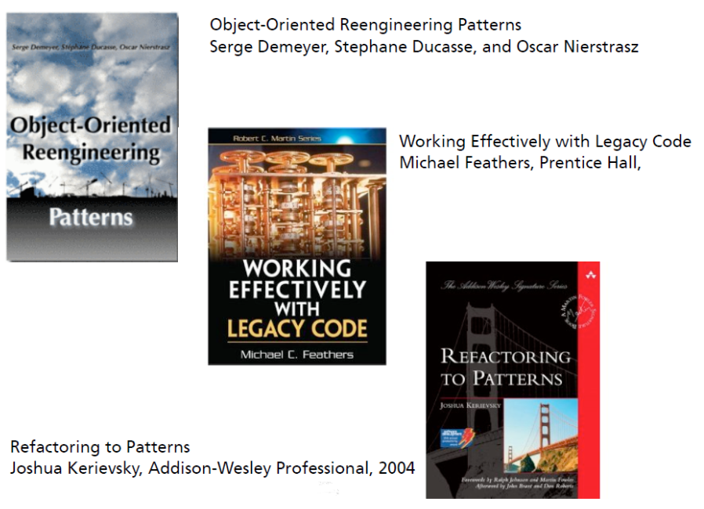
Reading material

Slide 5
A Fairy Tale
Once upon a time there was a Good Software Engineer
whose Customers knew exactly what they wanted.
The Good Software Engineer worked
very hard to design the Perfect System that would
solve all the Customers’ problems now and for
decades. When the Perfect System was designed,
implemented and finally deployed, the Customers
were very happy indeed. The Maintainer of the
System had very little to do to keep the Perfect
System up and running, and the Customers and
the Maintainer lived happily every after.
Why isn’t real life more like this fairy tale?

Slide 6
Some reasons may be
Could it be because there are no Good Software Engineers?
Could it be because the Users don’t really know what they want?
Or is it because the Perfect System doesn’t exist?

Slide 7
Manny Lehman and Les Belady
Fundamental laws of software evolution:
1- The Law of Continuing Change —A program that is used in a real world
environment must change, or become progressively less useful in that environment.
2- The Law of Increasing Complexity — As a program evolves, it becomes more complex, and extra resources are needed to preserve and simplify its structure.

Slide 8
Lehman’s Laws in practice
Existing software Is often modified in an ad-hoc manner (quick fixes)
Lack of time, resources, money, etc.
Initial good design is not maintained
Spaghetti code, copy/paste programming, dependencies are introduced, no tests, etc.
Documentation is not updated (if there is one)
Architecture and design documents
Original developers leave and with them their knowledge

Slide 9
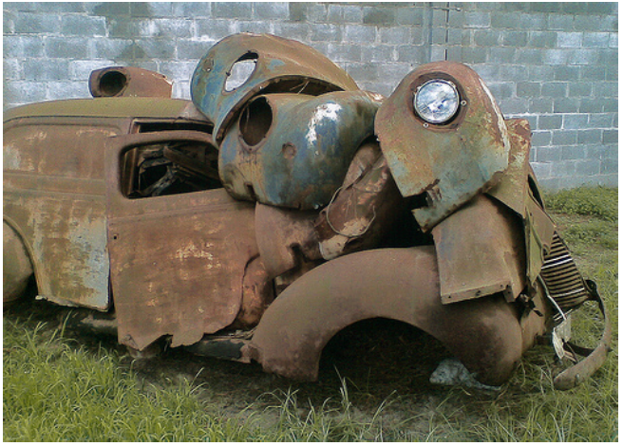
Typical result of such practices

Slide 10
Implications of the results
Software maintenance costs continuously increase
Between 50% and 75% of global software development costs are spent on maintenance!
Up to 60% of a maintenance effort is spent on understanding the existing software

Slide 11
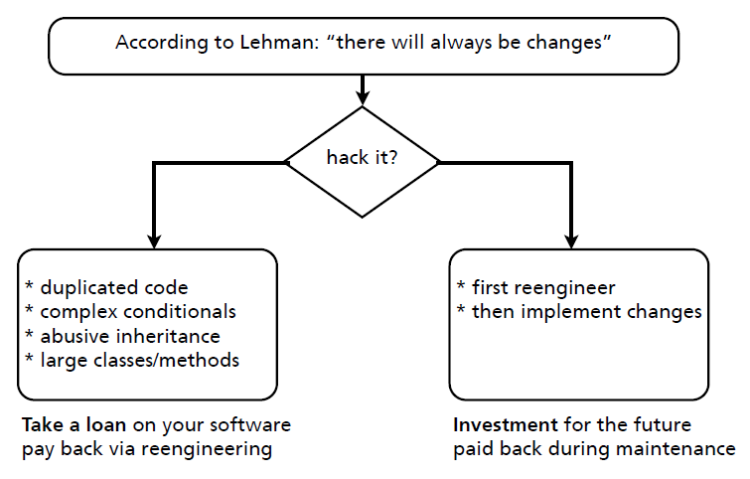
What is your decision?

Slide 12
Let’s reengineer
Definition:
“Reengineering is the examination and alteration of a subject
system to reconstitute it in a new form and the subsequent
implementation of the new form.”
[Demeyer, Ducasse, Nierstrasz]

Slide 13
Points to remember
Examination and alteration
Reconstitute new form
Implementation of the new form

Slide 14
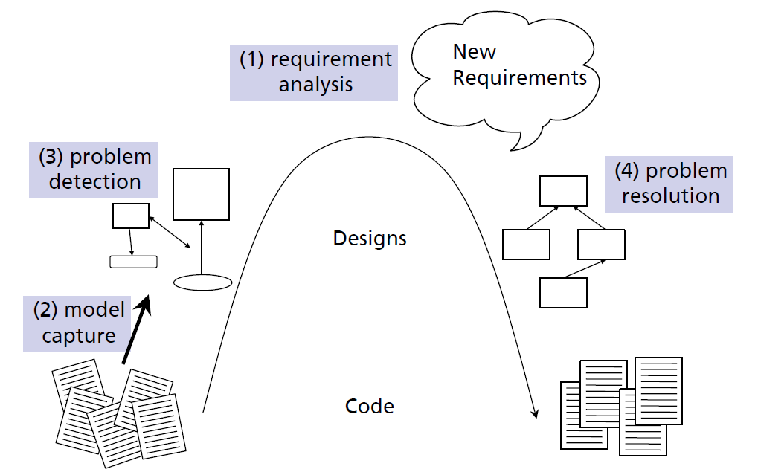
Reengineering Life-Cycle

Slide 15
Goals of reengineering
Testability
Understandability
Modifiability
Extensibility
Maintainability

Slide 16
Goals of reengineering (conrete)
Unbundling
Split a monolithic system into parts that can be separately marketed
Performance
“First do it, then do it right, then do it fast”
Design extraction
To improve maintainability, portability, etc.
Exploitation of New Technology
I.e., new language features, standards, libraries, etc.

Slide 17
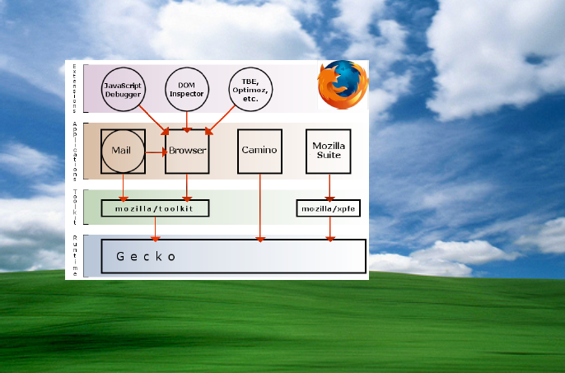
Greenfield Software Development

Slide 18
Greenfield development
Developing a system for a totally new environment and
Requires development from a clean slate
No legacy code around.
It is an approach used when you’re starting fresh and
with no restrictions or dependencies.

Slide 19
Brownfield Software Development
Non-GreenField Software Development.
The development and deployment of a new software system in the presence of existing or legacy software systems.
It happens when we want to develop or improve upon an existing application, and
Compels us to work with previously created code.

Slide 20
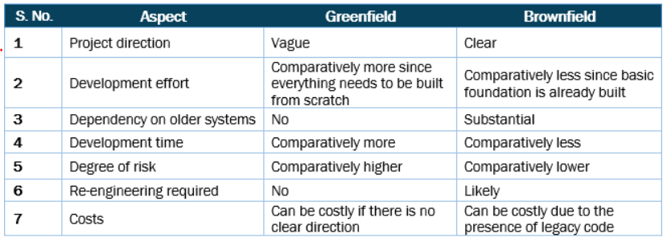
Comparison Overview

Slide 21
How do you know when you have a legacy problem?
Common wisdom says, “If it ain’t broke, don’t fix it.”
From a functional point of view, something is broken only if it no longer delivers the function it is designed to perform.
From a maintenance point of view, however, a piece of software is broken if it can no longer be maintained.
So how can you tell that your software is going to break very soon?

Slide 22
warning signs
Obsolete or no documentation.
Missing tests.
Original developers or users have left.
Inside knowledge about system has disappeared. (documentation is out of sync)
Limited understanding of the entire system.
Too much time to make simple changes.
Need for constant bug fixes.
Maintenance Dependencies.
Big build times.
Duplicated code.

Slide 23
Re Vs Reverse
“Reverse Engineering is the process of analyzing a subject system
to identify the system’s components and their interrelationships
and create representations of the system in another
form or at a higher level of abstraction.”
“Reengineering ... is the examination and alteration of a subject
system to reconstitute it in a new form and the subsequent implementation
of the new form.”

Slide 24
Reverse engineering is essentially concerned with trying
to understand a system and how it ticks.
Reengineering, on the other hand, is concerned with restructuring a system,
generally to fix some real or perceived problems

Slide 25
